Slide 1
Multimedia Systems Lecture – 28
By
Dr. Priyambada Subudhi
Assistant Professor
IIIT Sri City

Slide 2
Lossy Compression
Entropy-coding or lossless compression has theoretical limits on the amount of compression that can be achieved.
In certain situations, it might be necessary and appropriate to sacrifice some amount of information and thereby increase the compression obtained.
For instance, human visual experiments on image perception have shown distortion introduced by image compression is still perceptually acceptable.
In such cases, the original signal cannot be recovered in its entirety and there is a loss or distortion introduced.
Most lossy compression schemes introduce a distortion because of quantizing the symbol code representations.
Quantization is inherently lossy.

Slide 3
Transform Coding
Transform coding techniques work by performing a mathematical transformation on the input signal that results in a different signal.
These transformation changes the signal representation to a domain, which can result in reducing the signal entropy and, hence, the number of bits required to compress the signal.
Transform coding techniques by themselves are not lossy; however, they frequently employ quantization after a transform.
Transform techniques can be grouped as follows:
Frequency transforms—Discrete Fourier transforms, Hadamard transforms, Lapped Orthogonal transforms, Discrete Cosine transforms
Statistical transforms—Karhunen-Loeve transforms
Wavelet transforms—While similar to frequency transforms, these transforms work more efficiently because the input is transformed to a multiresolution frequency representation

Slide 4
Image Compression Techniques
An explosion in the availability of digital images, because of the increase in numbers of digital imaging devices.
The need to efficiently process and store images in digital form has motivated the development of many image compression standards.
Image compression techniques can be purely lossless or lossy, but good image compression techniques often work as hybrid schemes.
These schemes aim to get compression by typically analyzing the image data according to two important aspects:
Irrelevancy reduction: information associated with some pixels might be irrelevant and can, therefore, be removed. visual irrelevancy and application-specific irrelevancy.
Redundancy reduction: statistical redundancy because pixel values are not random but highly correlated, either in local areas or globally

Slide 5
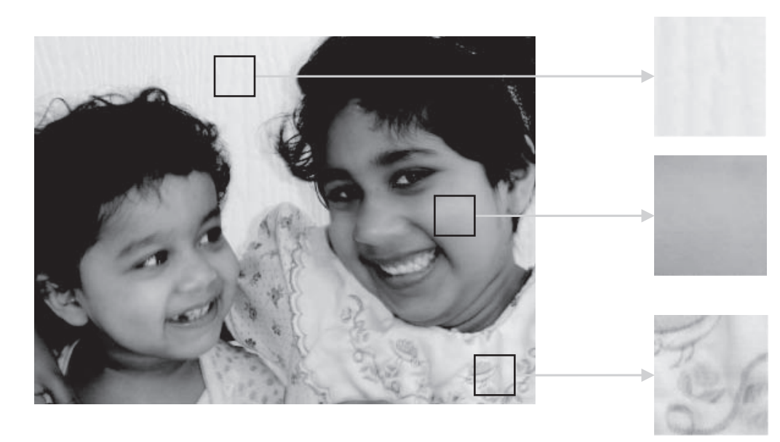
Local pixel correlation. Images are not a random collection of pixels, but exhibit a similar structure in local neighborhoods. Three magnified local areas are shown on the right

Slide 6
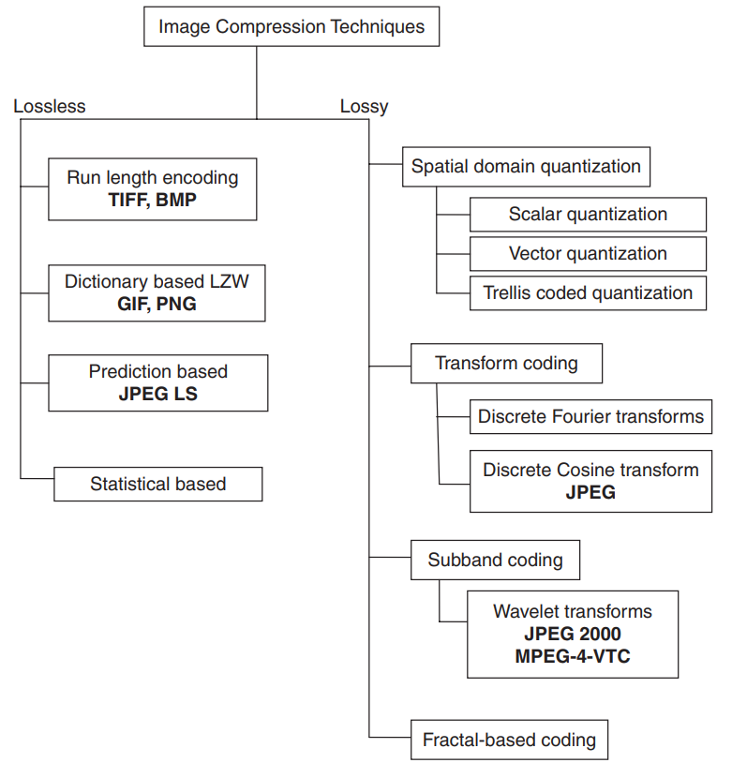
Image Compression Taxonomy

Slide 7
DCT Image Coding and the JPEG Standard
The JPEG standard is based on a transform image coding technique that utilizes the Discrete Cosine transform (DCT).
The DCT was chosen by the JPEG community because of its good frequency domain energy distribution for natural images, as well as its ease of adoption for efficient hardware-based computations.
To understand how compression occurs in the JPEG pipeline, it is imperative that the DCT behavior be well understood.

Slide 8


Discrete Cosine Transform (DCT)
The Discrete Cosine Transform (DCT), a widely used transform coding technique, is able to perform decorrelation of the input signal in a data-independent manner.
Definition of DCT
Given a function f (i, j) over two integer variables i and j (a piece of an image), the 2D DCT transforms it into a new function F(u, v), with integer u and v running over the same range as i and j.
The general definition of the transform is
where i, u = 0, 1,..., M − 1, j, v = 0, 1,..., N − 1, and the constants C(u) and C(v) are determined by

